Slide 1
Mental Health in the Workplace and Around the World
Ruchi Chandrawal, Emily Curlin, Lauren Phelps, Tye Smith, Steve Tuttle, Tyler Williams

Slide 2
Aim of Analysis: using a micro and macro level approach to the evaluation of the following questions we hope to better understand: 1) how various socio-demographic factors influence self-reported mental health and care-seeking behaviors in the workplace, 2) how mental health diagnosis and the burden of these diseases quantitatively differs from region to region.
How does type of mental illness and relative prevalence vary by geographic location?
Is a person’s age and/or gender associated with their likelihood of seeking mental health treatment?
What are the strongest predictors that an employee will self-report that their mental health interferes with their work?
Which workplace factors most strongly predict if an employee will self-report seeking treatment for their mental health?
Based on this data, do commonly sought out factors such as remote work and provision of mental health benefits seem to be associated with with a reduction in employee reports of mental health interfering with work?
Are employees with mental health benefits more likely to seek treatment for their mental health?

Slide 3

The economic impact of mental health is a complex and multifaceted issue that can have significant implications for individuals, families, businesses, and societies as a whole
Healthcare Costs: Treating mental health disorders can be expensive, straining healthcare systems.
Disability: Severe mental health conditions can result in long-term workforce exclusion.
Educational Impact: Mental health challenges can hinder learning and educational achievement.
Economic Growth: Widespread mental health problems can limit productivity and innovation.
Caregiver Strain: Family caregivers might face income loss due to providing care.
Crime and Legal Costs: Mental health-related issues can lead to higher crime rates and legal expenses.
Stigma and Treatment: Stigma prevents timely treatment seeking, leading to increased costs.
Innovation: Good mental health support fosters innovation and creative thinking.
Intangible Costs: Human suffering and reduced quality of life also impact societies.
Workplace Productivity and Absenteeism: Mental health issues can lead to decreased productivity and increased absenteeism in the workplace. Conditions like depression, anxiety, and stress can affect concentration, decision-making, and overall job performance. This can result in lower efficiency and reduced output for businesses.

Slide 4
Sources of Data
Survey on Mental Health in the Tech Workplace in 2014 (ongoing data available)
Global Mental Illness Prevalence by Type
Global Burden of Mental Illness by Type (measured as DALYs)
Definitions
Prevalence:
proportion or percentage of a specific population that has a particular disease or condition at a given point in time.
DALY= Disability Adjusted Life Year :
combines the years of healthy life lost due to early death and the years lived with a disability or illness.

Slide 5
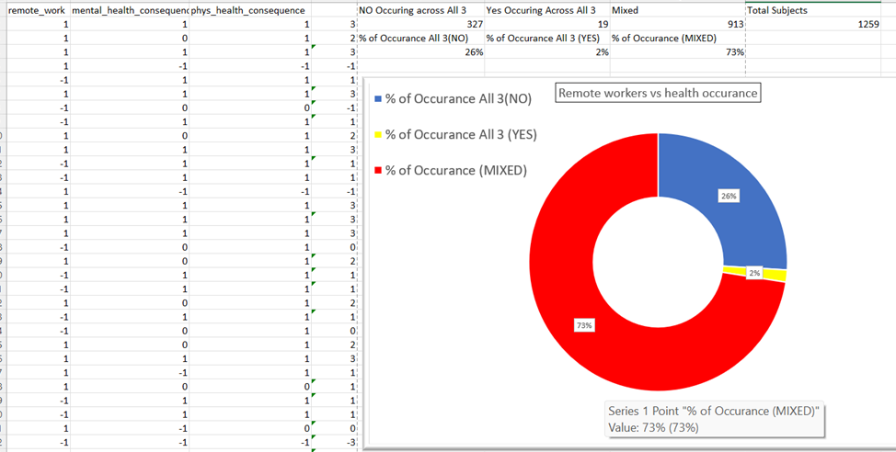
Assigning a Value to Health

Slide 6
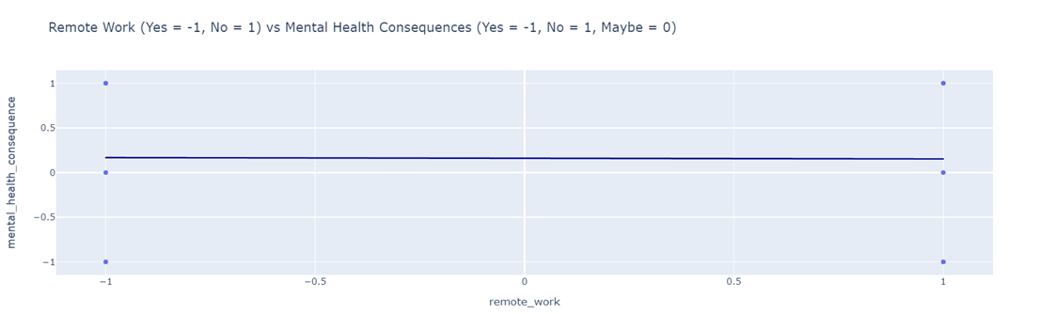
Correlation Coefficient
Remote Work vs Mental Health Correlation- ( 1 positive correlation, 0 No Correlation, -1 Negative Correlation)

Slide 7
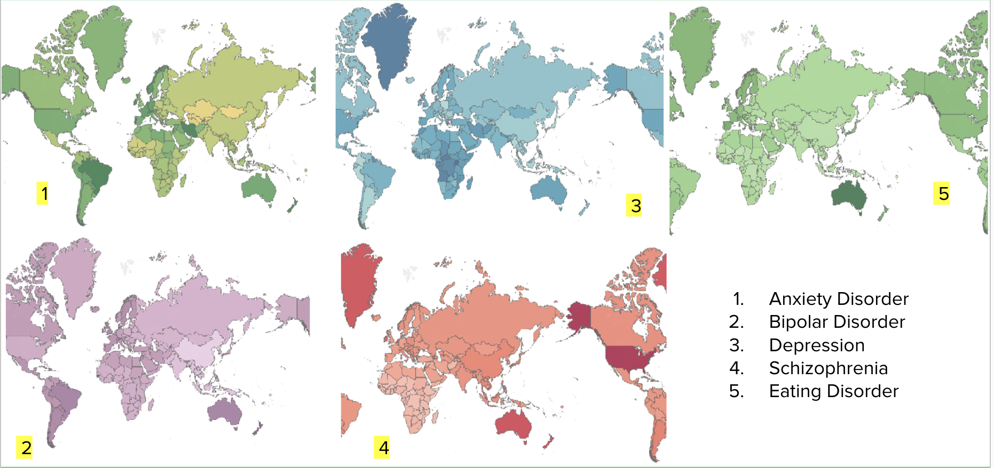
Mental Disorder Impact Worldwide

Slide 8
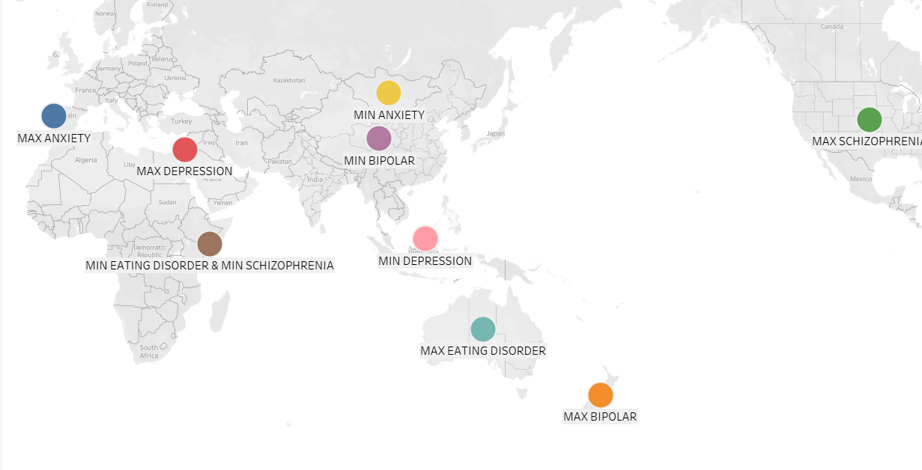
Maximum and Minimum Disorder Impact Worldwide

Slide 9
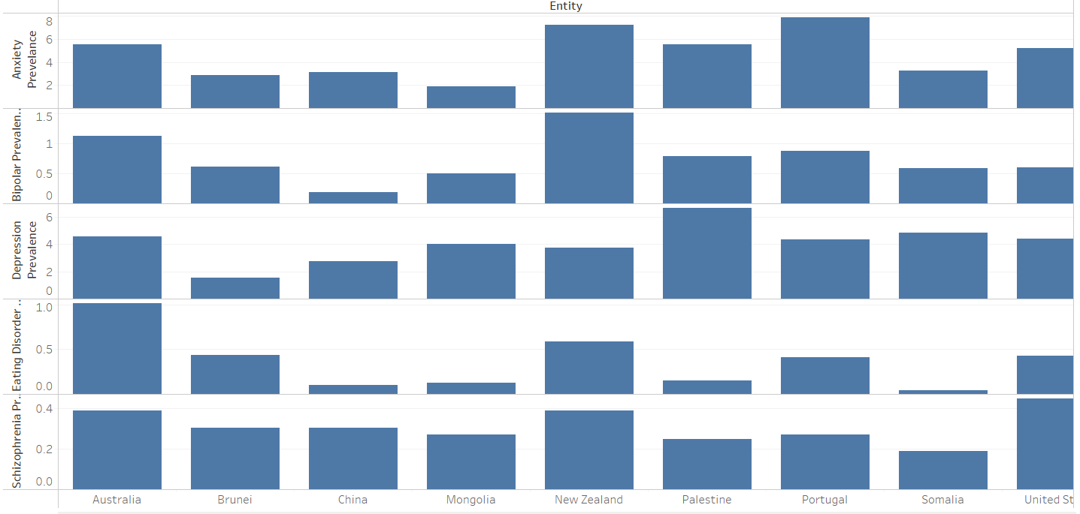
Countries with Maximum and Minimum Disorder Compared

Slide 10
Possible Common Causes for Poor Mental Health Among Men and Women:
Younger Patients:
Social Pressures
Peer Relationships
Academic Stress
Body Image and Self Esteem
Middle of Range:
Work-Life Balance
Career Progression
Parenting and Caregiving
Hormonal Changes
Older Patients:
Empty Nest Syndrome
Aging and Self Care
Lack of Social Network
Loneliness

Slide 11
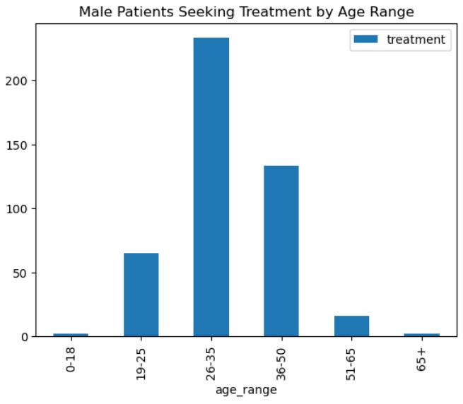
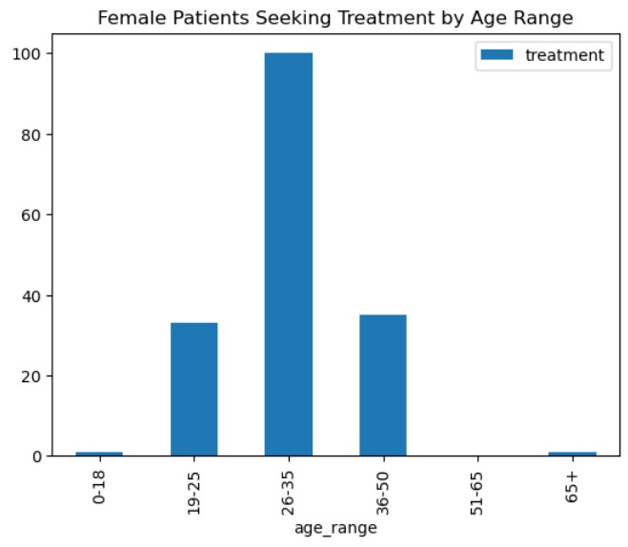
Comparison of female and male patients who sought treatment by age range.

Slide 12
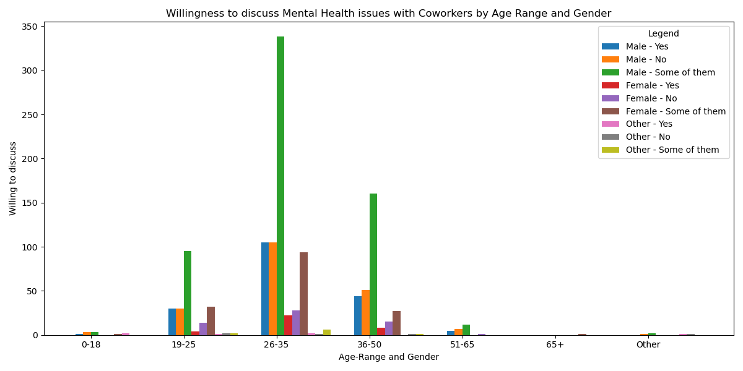
Survey Question: Would you be willing to discuss a Mental Health issue with your coworkers? Here, we look at the results of that question based on the respondents age range and gender.

Slide 13
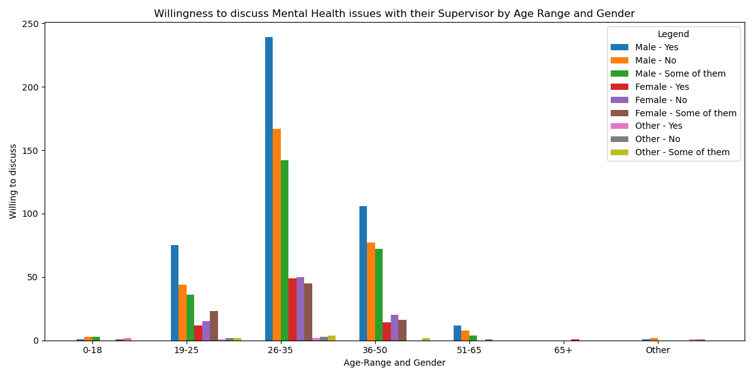
Survey question: Would you be willing to discuss a Mental Health issue with your supervisor(s)? Here, we look at the results of that question based on the respondents age range and gender.

Slide 14
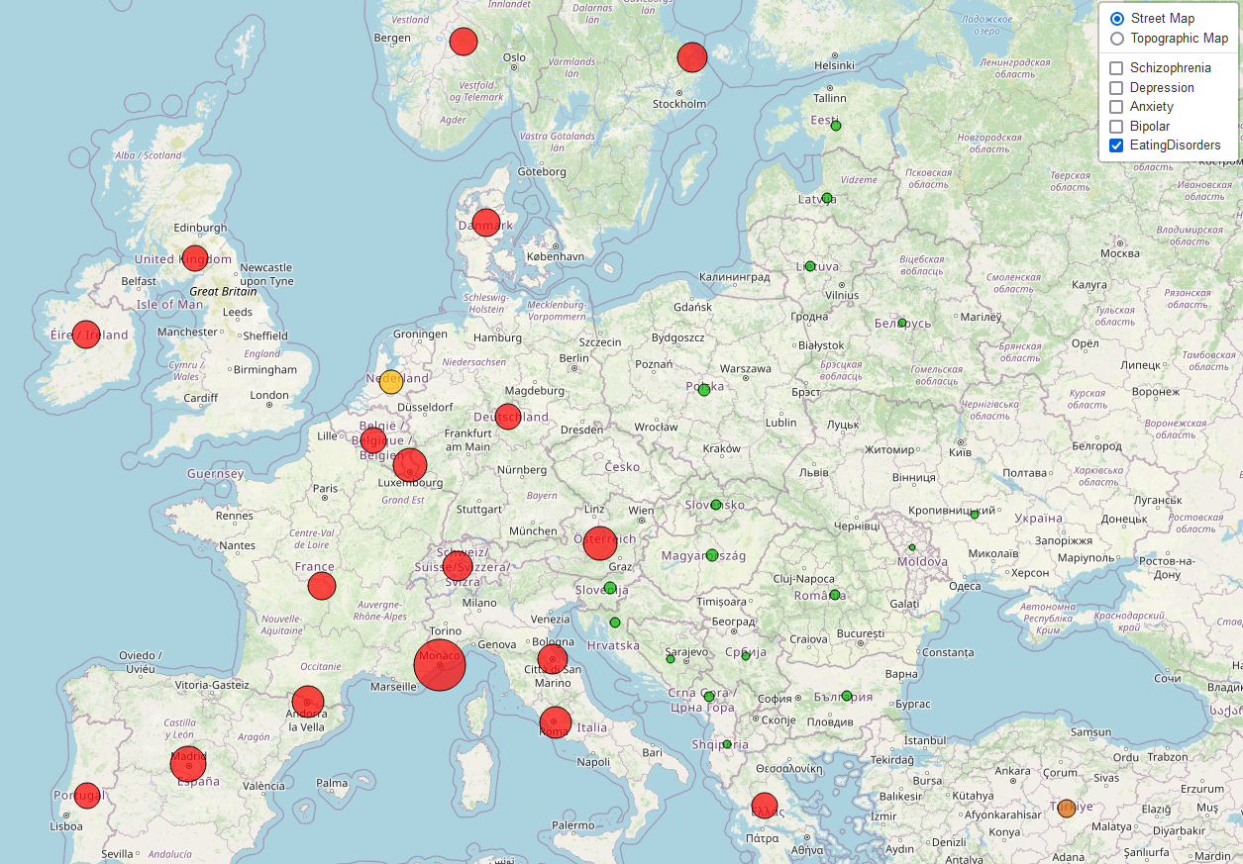
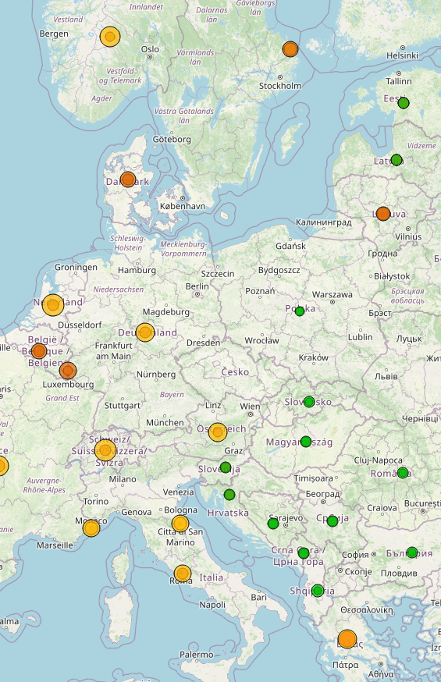
Constructed in leaflet
Comes with 5 layers that can be mixed and matched
Displays data from 2019 for most countries in the world
Interactive Map

Slide 15
Encode Categorical Data into Numerical
OneHotEncoder
Split Data into Testing and Training Data
Identify features to be included in model
Apply the Models
Logistic Regression
Label Encoder
Train_test_split
Interpret the results
Decision Tree
Random Forest
Clean and Explore Data
Scale the Data
Descriptive Statistics
Array shapes
Standard Scaler
Accuracy score
Confusion Matrix

Slide 16
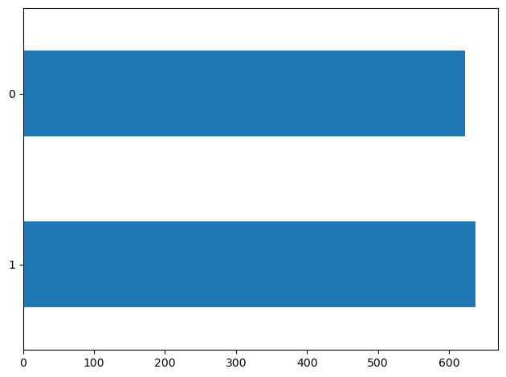
No
Yes

Slide 17
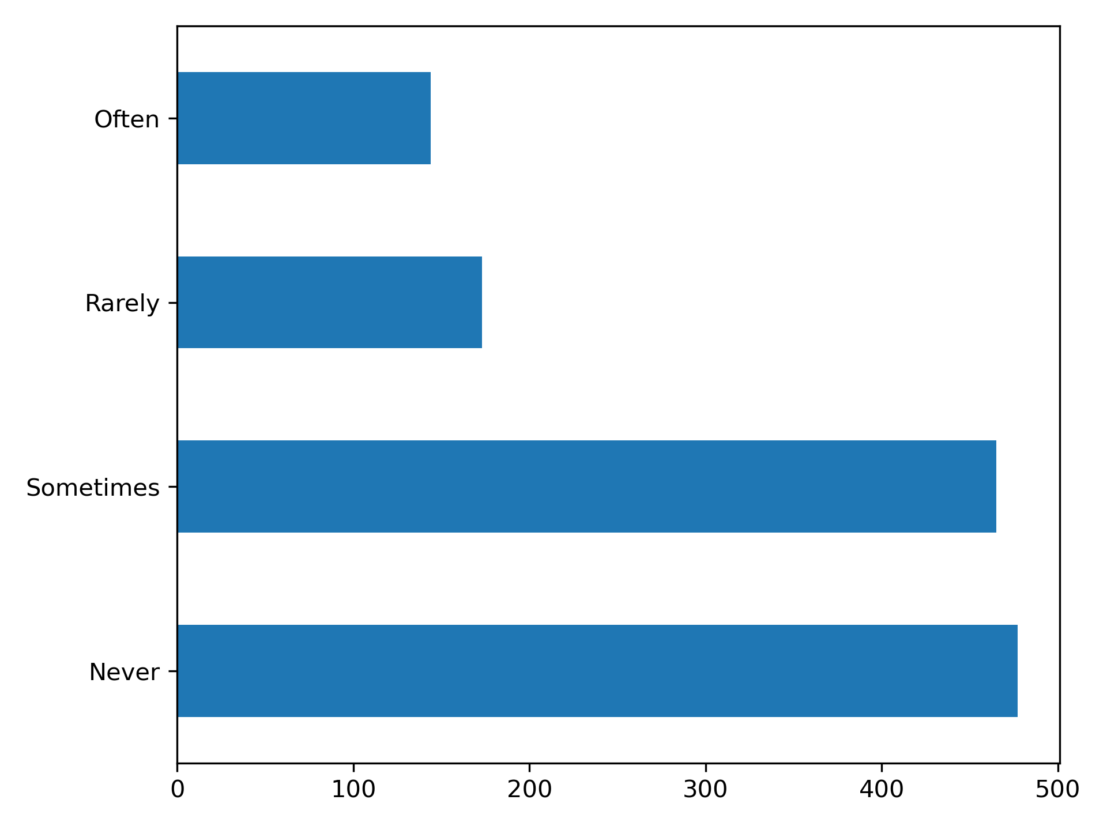
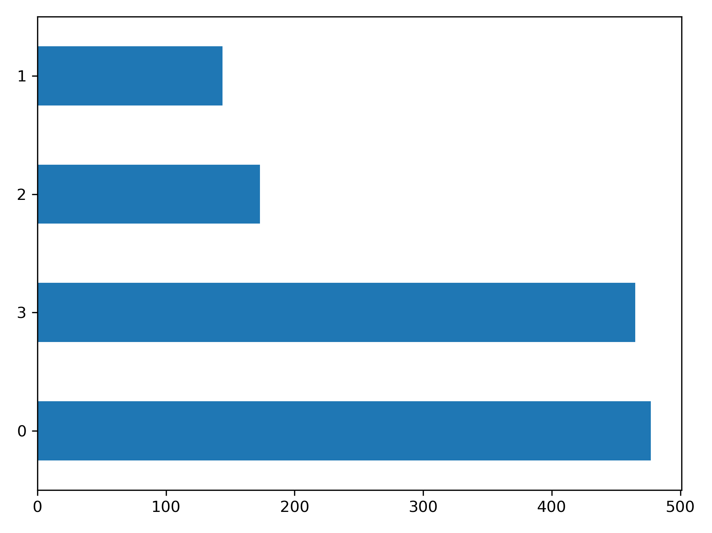
If you have a mental health condition, do you feel that it interferes with your work?

Slide 18
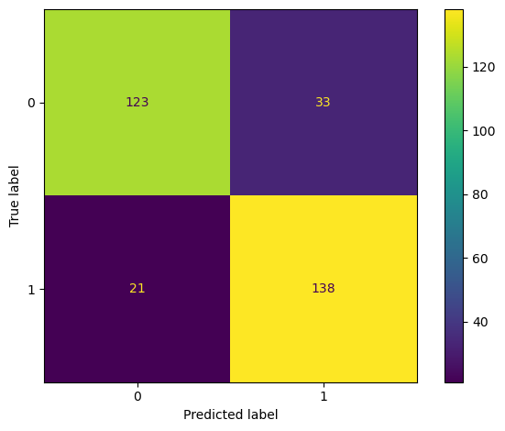
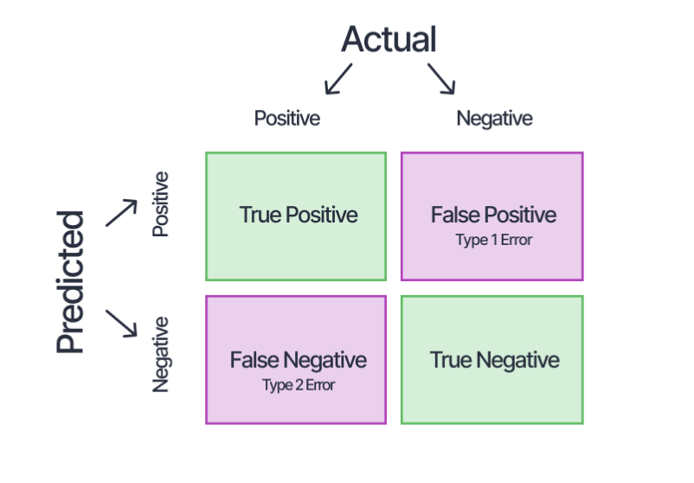
Confusion Matrix for Random Forest Classifier when predicting Treatment

Slide 19
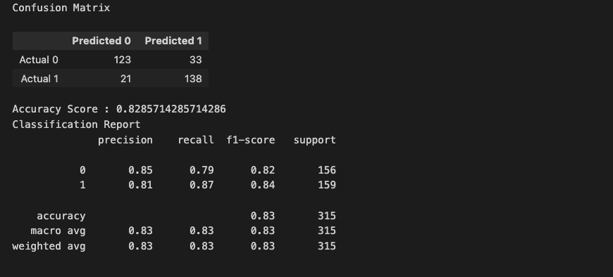

Slide 20
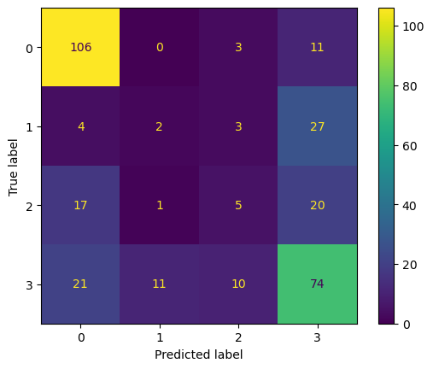
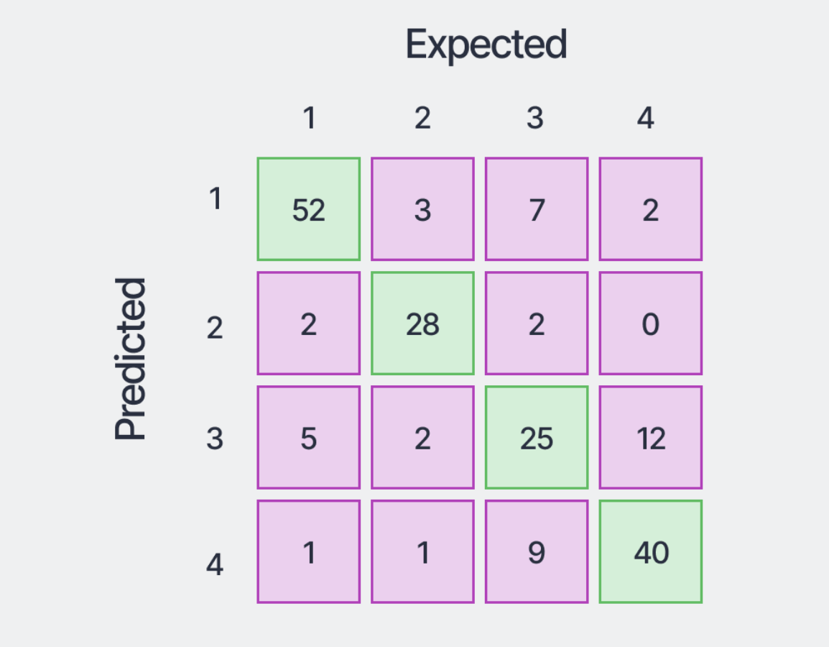
Confusion Matrix for Random Forest Classifier when predicting Interference

Slide 21
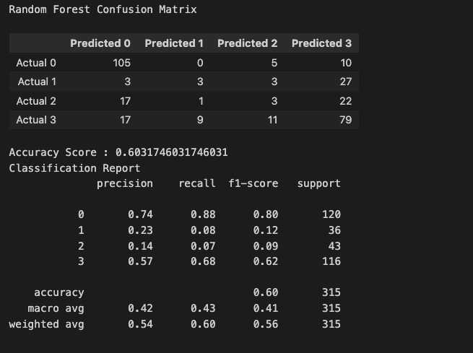

Slide 22
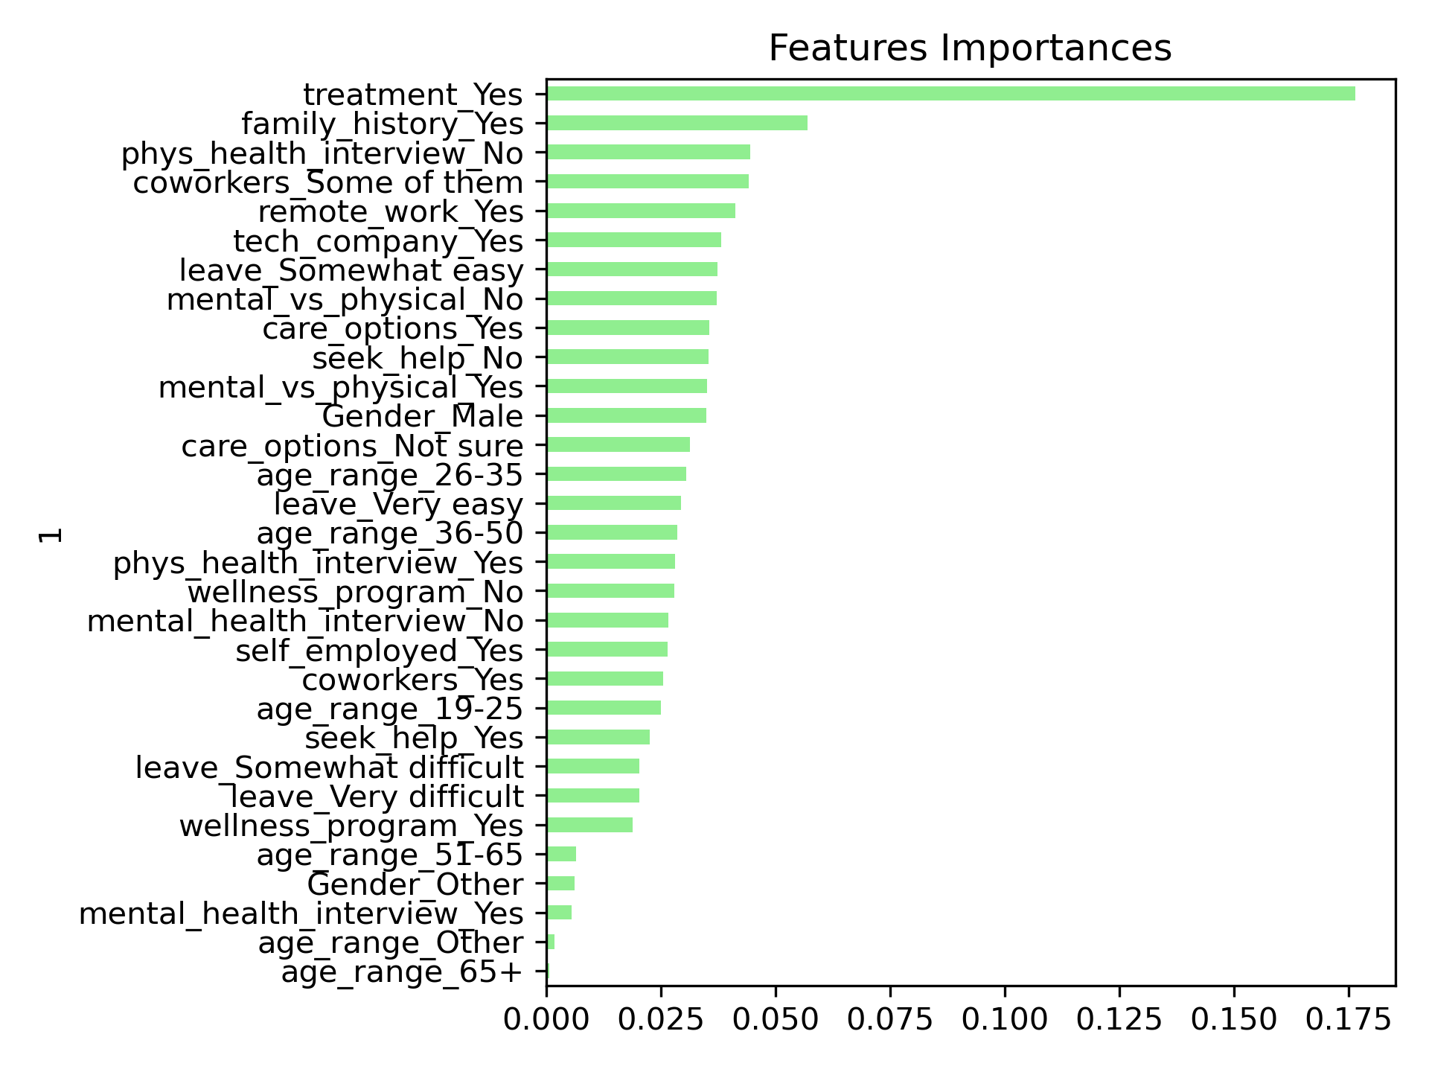
Feature Importance: Based on Random Forest Model Predicting: If an employee will report mental health interferes with their work
Notes:
Have you sought treatment for a mental health condition?

Slide 23
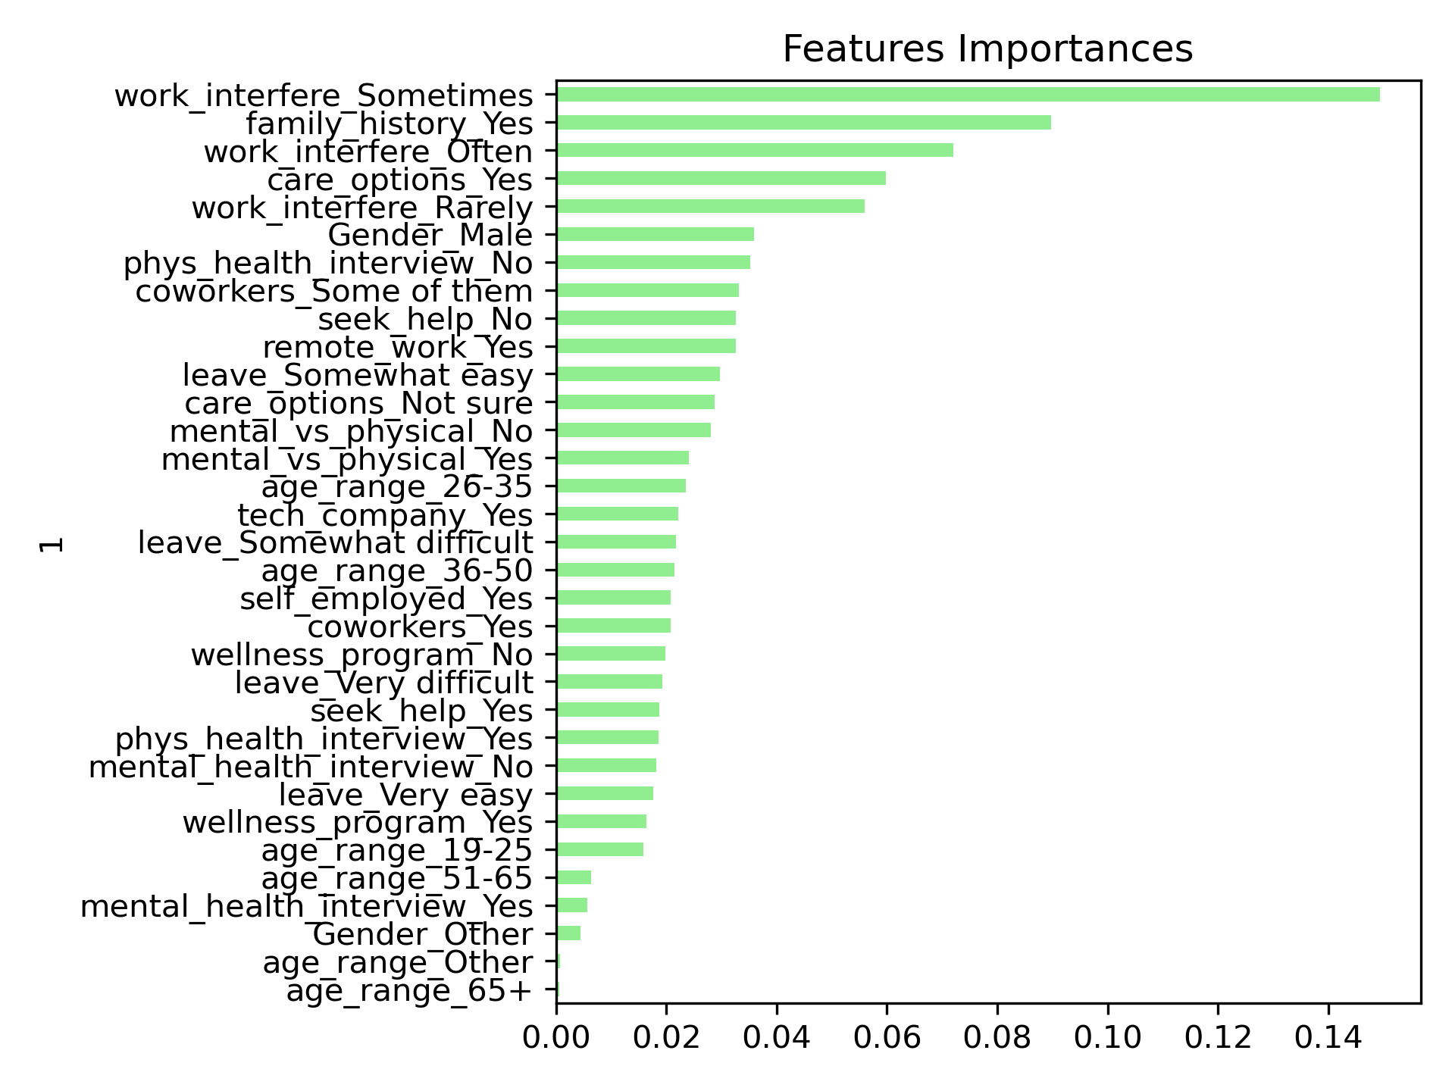
Feature Importance:
Based on Random Forest Model
Predicting: If an employee will seek mental health treatment
Notes:
If you have a mental health condition, do you feel that it interferes with your work?

Slide 24
Predictive Models
Model Accuracy Scores by Model and Outcome Predicted
Seeking treatment for mental health | Reporting mental health interferes with work
Logistic regression: .8667 | Logistic regression: .6317
Decision Tree Classifier: .7206 | Decision Tree Classifier: .47301
Random Forest: .8286 | Random Forest: .6031

Slide 25
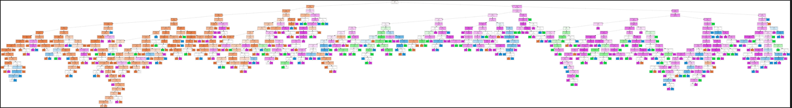
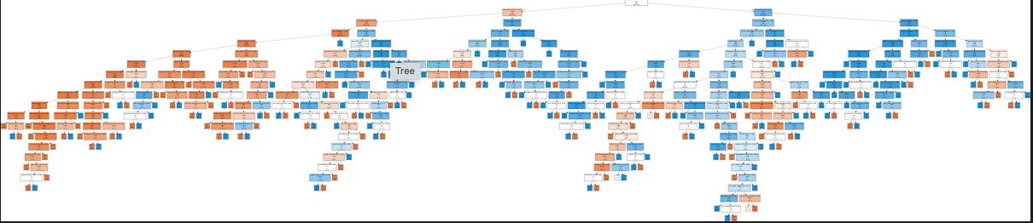
file:///private/var/folders/pv/t81hm_b11w928thx1b0w_8xh0000gn/T/graph-302469kQli67YjggV.html
file:///private/var/folders/pv/t81hm_b11w928thx1b0w_8xh0000gn/T/graph-30246bQBLy8q22WZQ.html
Notes:
Constructed in leaflet
Comes with 5 layers that are able to be mixed and matched
Displays data from 2019 for most countries in the world

Slide 26
Why a company should care ?
Workplace Productivity and Absenteeism: Mental health issues can lead to decreased productivity and increased absenteeism in the workplace. Conditions like depression, anxiety, and stress can affect concentration, decision-making, and overall job performance. This can result in lower efficiency and reduced output for businesses.
What a company can do to promote mental health:
Ensure employees feel better able to access treatment
Consider availability of care options, assessing if mental health is interfering with employee’s work, availability of care options, access to remote work
Assess factors that predict when a person will report their mental interferes with with work

